Slide 1


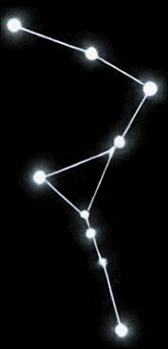


Myanmar Logistics Tracking System
Rapid Prototype for Smarter Logistics Monitoring
Assignment: AIEF-2, Assignment 5
Instructor : Dr. Ye Kyaw Thu
Group 4 members:
Aung Khant Myat, Htoo Eaindra Tin , Kyawt Kyawt Zin, Kaung Myat Kyaw
Min Khant Kyaw , Myint Thu Soe , Myo Thet, Soe Thandar Tint , Thida Aye ,
Thant Sin Tun , Wai Yan Htet Aung

Slide 2






The Problem
Border gate closures and checkpoints cause customs delays and route disruption
Traders, drivers and managers lack
timely shipment status and delay information
Fragmented communication across stakeholders leads to shipment delays
Route disruption
Communication gap
Shipment delay
Lack of visibility

Slide 3













Proposed Solution
Trader
  Request shipments
  Track status
  Receive alerts
Admin
  Manage routes
  Monitor shipments
  Assign drivers
  Handle alerts and users
Central Logistics Tracking System
Driver
  View assignments
  Update status and location
  Upload documents

Slide 4
































How the System Works
End-to-end workflow with smart disruption handling
1
2
3
4
5
6
7
8
Trader requests shipment
Admin assigns
driver
Driver picks up shipment
Driver updates status and location
Admin monitors
in real time
Route disruption, checkpoint or delay
System updates status and sends alerts
Trader and Driver notified
Route status
Shipment status
Status Update Example
OPEN
CLOSED
IN TRANSIT
DELAYED

Slide 5

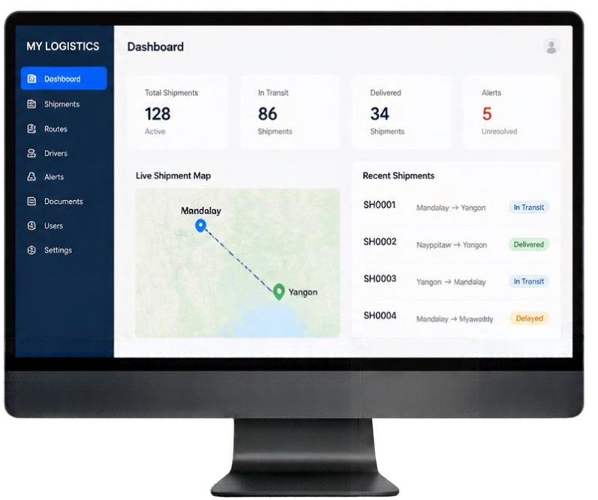

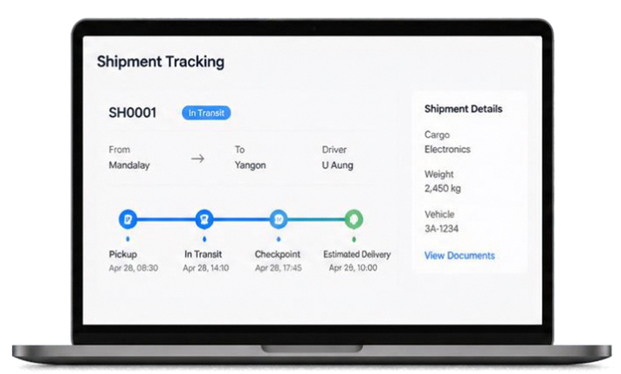
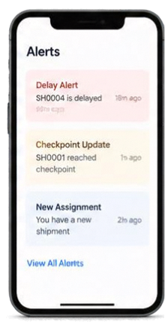
Prototype Demonstration
  Role-based login & access
  Admin dashboard & route management
  Live shipment map & tracking timeline
  Driver assignment & location updates
  Alerts & notifications system
  User profiles & shipment document viewing
  Trader/Driver self-signup
From fragmented logistics communication to centralized shipment visibility.

Slide 6

Challenges & Future Work
FUTURE WORK
CHALLENGES
  Implementation for Driver role in Mobile application
  More user-friendly web design
  Cloud Deployment
  No prior experiences in Mobile Applications
  Vibe coding alone is not enough to implement
  Dependencies mismatch Errors
  Learning & Growing (not only as an individual but also as a team)

Slide 7
References
  Supabase. (2026). Supabase Documentation. Supabase Documentation
  Supabase. (2026). Database: PostgreSQL. Supabase Database Documentation
  Supabase. (2026). Authentication. Supabase Auth Documentation
  Supabase. (2026). Edge Functions. Supabase Edge Functions Documentation
  React. (2026). React Documentation. React Documentation
  Leaflet. (2026). Leaflet Documentation. Leaflet Documentation
  Our Repository: Myanmar Logistics Tracking: LLM-assisted rapid prototype for real-time logistics monitoring and tracking in Myanmar. GitHub. GitHub Repository

Slide 8
Thank You

